Slide 1
Heuristic Evaluation
Evaluating with experts

Slide 2
Discount Evaluation Techniques
Basis:
  Observing users can be time-consuming and expensive
  Try to predict usability rather than observing it directly
  Conserve resources (quick & low cost)

Slide 3
Approach - inspections
Expert reviewers used
  HCI experts interact with system and try to find potential problems and give prescriptive feedback
  Best if
    Haven’t used earlier prototype
    Familiar with domain or task
    Understand user perspectives

Slide 4

Discount Evaluation Methods
Scenarios
Heuristic Evaluation
Cognitive Walkthrough
  Separate presentation

Slide 5

Heuristic Evaluation
Developed by Jakob Nielsen
Several expert usability evaluators assess system based on simple and general heuristics (principles or rules of thumb)
(Web site: www.useit.com)

Slide 6
Heuristic Evaluation
Mainly qualitative
use with experts
predictive

Slide 7
Procedure
Gather inputs
Evaluate system
Debriefing and collection
Severity rating

Slide 8
1: Gather Inputs
Who are evaluators?
  Need to learn about domain, its practices
Get the prototype to be studied
  May vary from mock-ups and storyboards to a working system

Slide 9
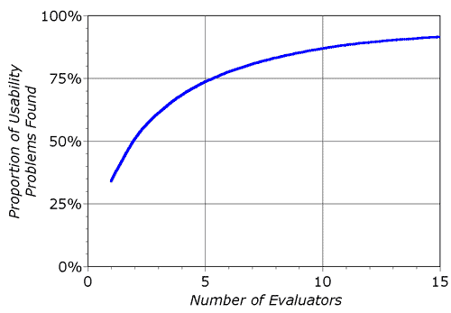
How many experts?
Nielsen found that
about 5 evaluations
found 75% of the
problems
Above that you get more, but at decreasing efficiency

Slide 10
2: Evaluate System
Reviewers evaluate system based on high-level heuristics.
Where to get heuristics?
  http://www.useit.com/papers/heuristic/
  http://www.asktog.com/basics/firstPrinciples.html

Slide 11
Heuristics
use simple and natural dialog
speak user’s language
minimize memory load
be consistent
provide feedback
provide clearly marked exits
provide shortcuts
provide good error messages
prevent errors

Slide 12
Neilsen’s Heuristics
visibility of system status
aesthetic and minimalist
design
user control and freedom
consistency and standards
error prevention
recognition rather than recall
flexibility and efficiency of use
recognition, diagnosis and recovery from errors
help and documentation
match between system and real world

Slide 13
Groupware heuristics
Provide the means for intentional and appropriate verbal communication
Provide the means for intentional and appropriate gestural communication
Provide consequential communication of an individual’s embodiment
Provide consequential communication of shared artifacts (i.e. artifact feedthrough)
Provide Protection
Manage the transitions between tightly and loosely-coupled collaboration
Support people with the coordination of their actions
Facilitate finding collaborators and establishing contact
Baker, Greenberg, and Gutwin, CSCW 2002

Slide 14
Ambient heuristics
Useful and relevant information
“Peripherality” of display
Match between design of ambient display and environments
Sufficient information design
Consistent and intuitive mapping
Easy transition to more in-depth information
Visibility of state
Aesthetic and Pleasing Design
Mankoff, et al, CHI 2003

Slide 15
Process
Perform two or more passes through system inspecting
  Flow from screen to screen
  Each screen
Evaluate against heuristics
Find “problems”
  Subjective (if you think it is, it is)
  Don’t dwell on whether it is or isn’t

Slide 16
3: Debriefing
Organize all problems found by different reviewers
  At this point, decide what are and aren’t problems
  Group, structure
  Document and record them

Slide 17
4: Severity Rating
Based on
  frequency
  impact
  persistence
  market impact
Rating scale
  0: not a problem
  1: cosmetic issue, only fixed if extra time
  2: minor usability problem, low priority
  3: major usability problem, high priority
  4: usability catastrophe, must be fixed

Slide 18
Advantages
Few ethical issues to consider
Inexpensive, quick
Getting someone practiced in method and knowledgeable of domain is valuable

Slide 19
Challenges
Very subjective assessment of problems
  Depends of expertise of reviewers
Why are these the right heuristics?
  Others have been suggested
How to determine what is a true usability problem
  Some recent papers suggest that many identified “problems” really aren’t

Slide 20
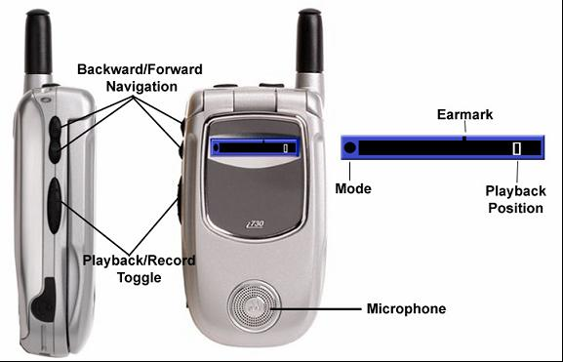
Let’s practice: PAL

Slide 21
Heuristics
use simple and natural dialog
speak user’s language
minimize memory load
be consistent
provide feedback
provide clearly marked exits
provide shortcuts
provide good error messages
prevent errors

Slide 22
Your turn:
Internet radio player
Use Nielsen’s heuristics (p 408)
List all problems
In a group, summarize and rate
We’ll talk about the most serious

Slide 23
Neilsen’s Heuristics
visibility of system status
aesthetic and minimalist
design
user control and freedom
consistency and standards
error prevention
recognition rather than recall
flexibility and efficiency of use
recognition, diagnosis and recovery from errors
help and documentation
match between system and real world

Slide 24
Next time
Heuristic evaluation of your own prototypes
Bring to class
  Your materials – sketches, storyboards, working prototype, etc.
  Set of heuristics you want them to use, print them out

Slide 25
Next time
Designate one person to explain prototype, answer questions to other group
Evaluate: group# + 1 (and 5 will evaluation for group 1)
Collect, organize and rate severity of problems, include in your part 4 writeup.

